Slide 1
University of Canterbury College of Science Outreach Programme
provided by the
Department of Geological Sciences

Slide 2
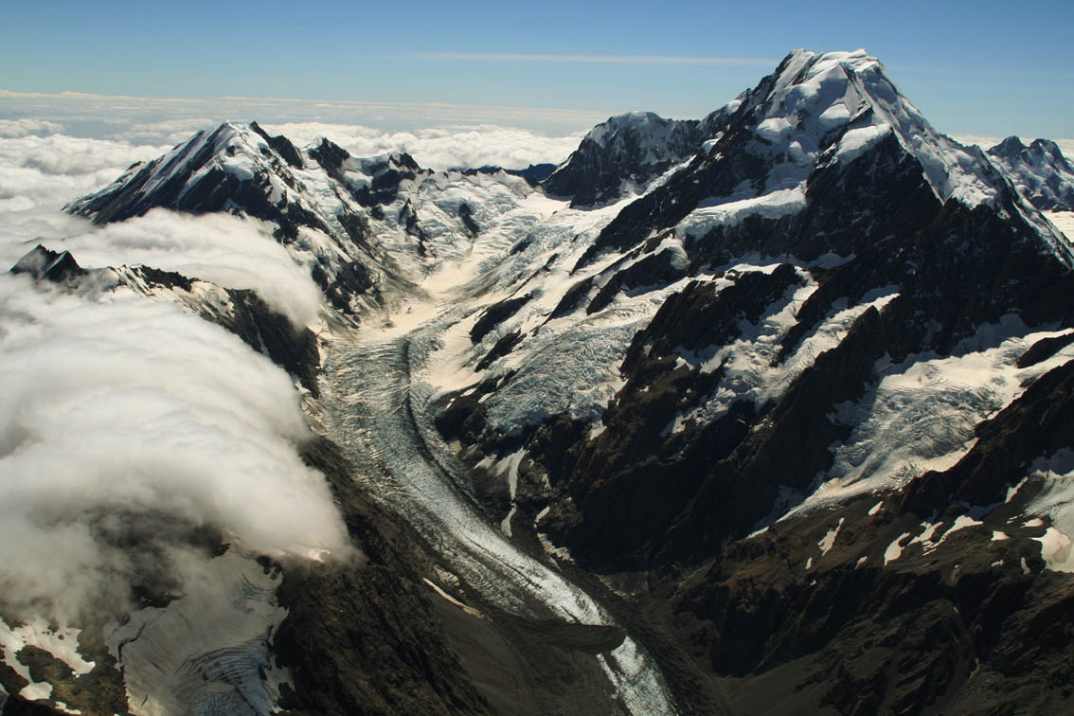
Does a glacier melt at night?
(Energy balance of glaciers)
Hooker Glacier and Mt Cook/Aoraki
Dr. Stefan Winkler
Department of Geological Sciences
University of Canterbnury
Notes:
This presentation examines the energy balance of glaciers. It consists of 16 slides
including questions for discussion.

Slide 3
Does a glacier melt at night?
or
What makes the glacier melt?
(Energy balance of glaciers)

Slide 4
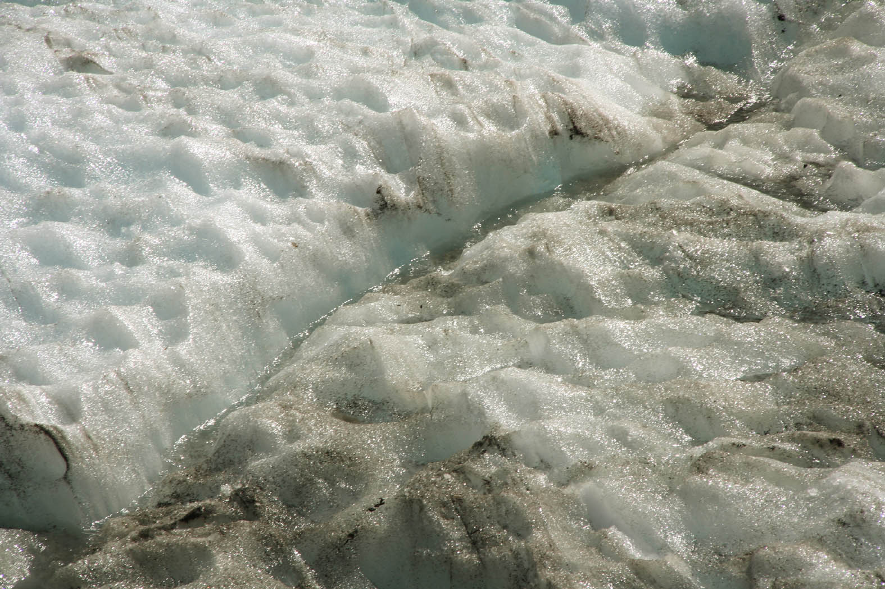
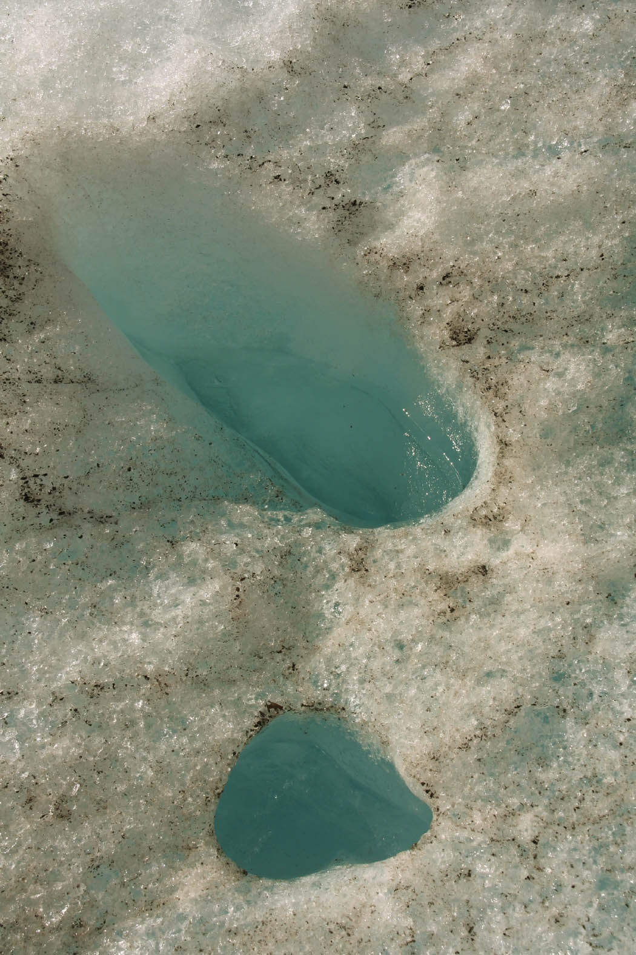
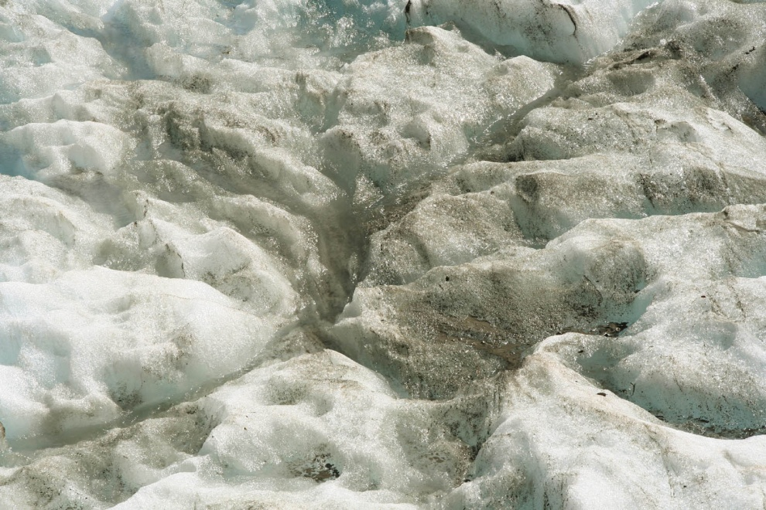
There is always surface melt of snow and ice on the lower parts of a glacier
(except sometimes during winter)
Surface melting on the lower glacier tongue of Franz Josef Glacier in Mid-November
Small streams often end in holes (called “moulins”) that connect to melt water channels inside the glacier
Notes:
Photo FJG melt

Slide 5
But does the glacier also melt at night?
Yes or NO
Make your decision!
Explain your decision!
Discuss it with your neighbour or in your group.
Ready for the correct answer?
Surprised? O.K., let’s learn what makes a glacier melt at all!

Slide 6
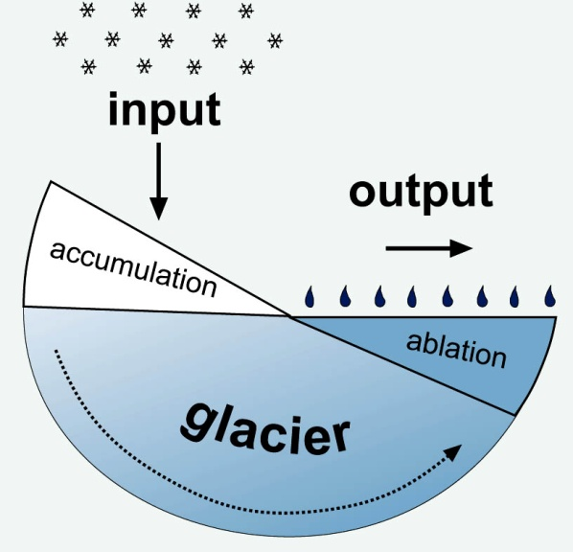
A glacier can be seen as an Input-Output-System. Input mainly is snow. This snow is over many years transformed into ice. Output is meltwater produced by the melt of snow and ice.
Here, we only want to consider the output - the melting of snow and ice. This mainly happens on the lower part of a glacier. Scientists call the mass loss of a glacier in general “ablation“.

Slide 7
The sun (its radiation) is responsible for most of the melting. But as glaciers also melt at night, there must be other reasons!
But first have a look at the evidence:

Slide 8
Measurements of surface melt (ablation) at several stakes on the lower surface of Franz Josef Glacier (07.11. to 09.11.2010)
What could be the reason?
There is melting during the night (i.e. with no sun shining)!

Slide 9
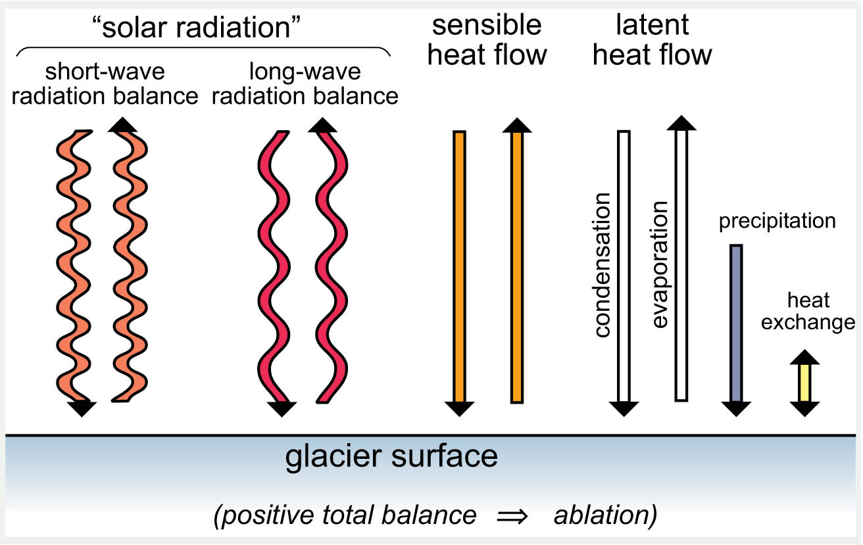
The “energy balance” of the glacier surface is not that simple:
Several factors need to be taken into account. But let‘s do it step by step!

Slide 10
1. Solar radiation (radiation of the sun)
If radiation from the sun (short-wave radiation) impacts on the glacier surface, it is either reflected, or transformed into long-wave radiation. Long-wave radiation is either absorbed by, or transmitted to the atmosphere. In total, there will be an energy surplus at the glacier surface causing melt of snow and ice.
By the way…

Slide 11
What effect has the colour of the surface for the amount of solar radiation absorbed vs. the amount of solar radiation reflected?
If three identical cars are parked outside with blue sky and the sun shining, which one will be coolest inside?
a) a black one b) a grey one c) a white one
Think, and then explain your answer!
The right answer is:
The same principle applies for glacier surfaces:

Slide 12
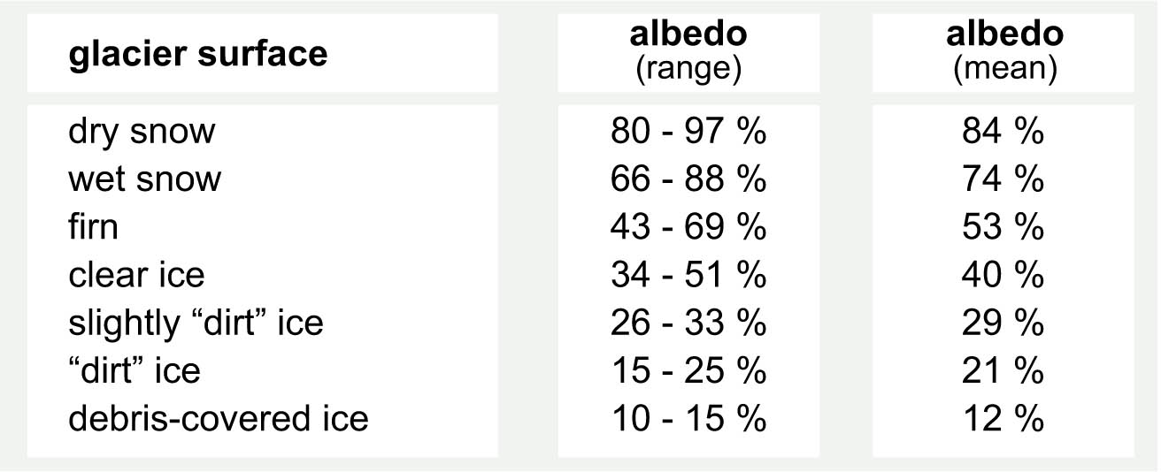
Albedo for different “types” of a glacier surface
(Albedo is a measure of how reflective a surface is)
Because glacier ice is not white but greyish-blue, it reflects less solar radiation than fresh snow so it absorbs more energy and melts faster.
The albedo of the glacier surface is a very important factor for the total amount of melting and the balance of the glacier mass.

Slide 13
Often, solar radiation contributes at least 50 % (sometimes even 90 % or more) to the total energy absorption for surface melt on a glacier. But there are two other factors….
Sensible and latent heat flow can both contribute significantly to the surface melt. With sensible heat flow, warm air cools down and the heat energy released will melt snow and ice. The more the cool air is replaced by “fresh” warm air, the more efficient this process will be.
That‘s why high wind speeds can increase melting!

Slide 14
Latent heat flow contributes to the surface melt if the air is moist and water condenses on the glacier surface. The energy released is absorbed, melting snow and ice.
Latent and sensible heat flow are equally or more important than solar radiation if the glacier is located in a relatively warm and moist climate (near the coast).
Other factors (like rain) can be neglected

Slide 15
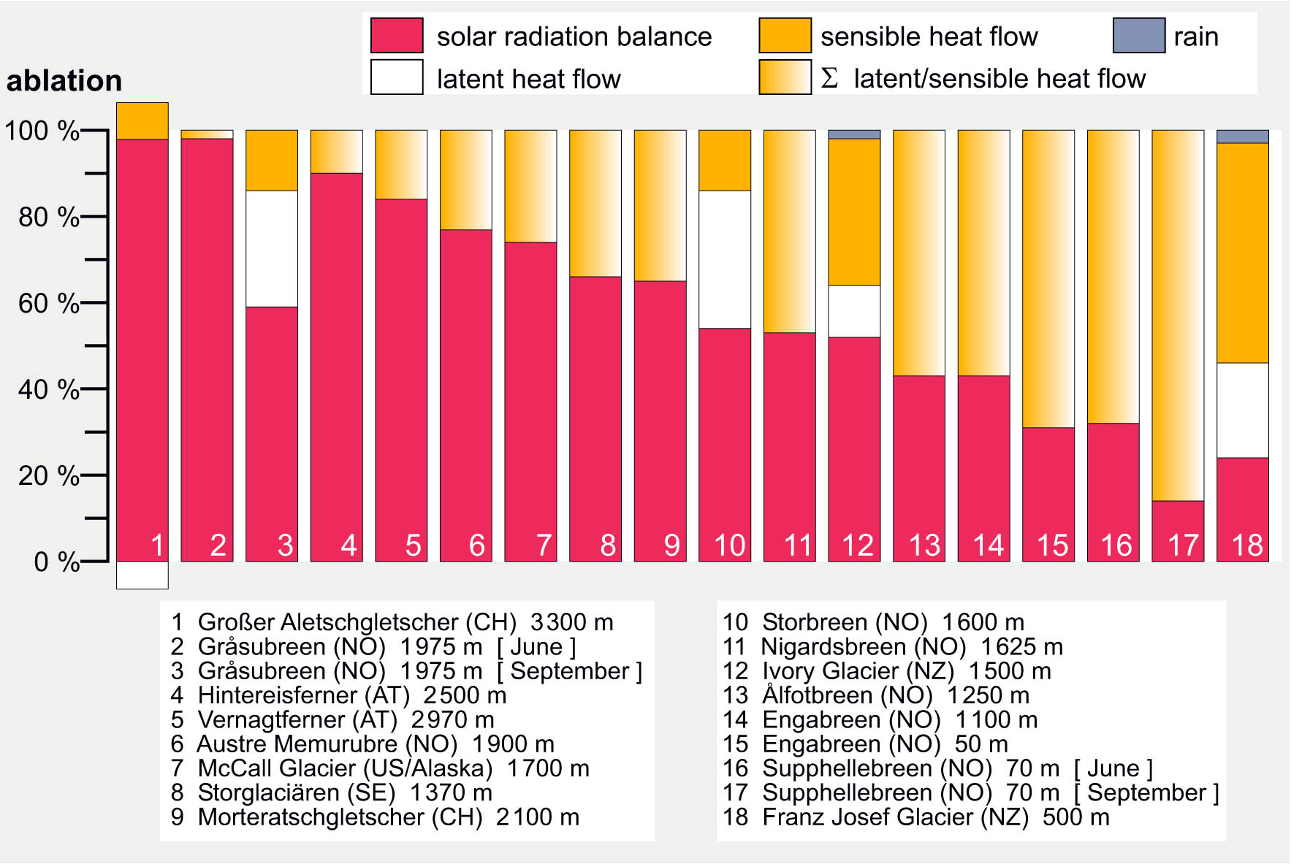
Comparison of the main factors causing surface melt (ablation) at different glacier all over the world
Are you ready and have discussed your ideas with your neighbour or in your group?
Try to locate these glaciers and explain the pattern shown!

Slide 16
Explaining the pattern: main factors causing surface melt
Glaciers 1 to 9 are continental and located at high altitudes. The air is relatively cold and dry. Therefore, melting is largely or almost entirely caused by solar radiation. The latent heat flow (# 1) can even be negative (when energy is lost by evaporation of melt water)

Slide 17
Explaining the pattern: main factors causing surface melt
Glaciers 10 to 18 are maritime and located at relatively low altitudes. The air can be mild and moist. Therefore, melting by latent and sensible heat flow is at least as important as melting by solar radiation.
The energy balance of a glacier is highly dependent on its location.

Slide 18
And finally, back to our initial question…
Does a glacier melt at night?
Yes!
There is surface melt also at night.
This surface melt is caused by latent and sensible heat flow and independent of the sun shining.
This surface melt at night is most likely expected at maritime glaciers near the coast where the air temperatures (also at night) are mild and the air is usually moist.
In New Zealand, Franz Josef Glacier and Fox Glacier at the West Coast are good examples of those type of glaciers.

