Slide 1
School of Business
Te Kura Umanga

Slide 2
The Marshmallow Challenge
Notes:
Created by Tom Wujec – for design

Slide 3
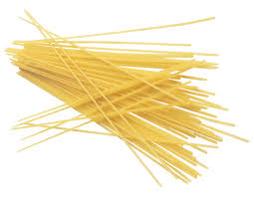
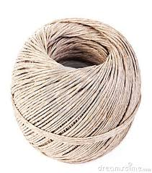
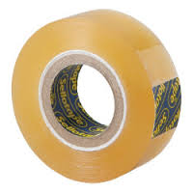
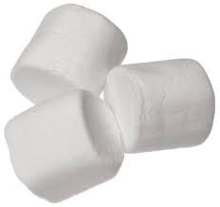
The Marshmallow Challenge
20 sticks of spaghetti 1 metre of tape 1 metre of string 1 marshmallow

Slide 4
Marshmallow Challenge Rules
Build the tallest FREESTANDING structure you can with the materials provided
You CANNOT suspend your structure from a higher structure nor be supporting it with any part of your body
The ENTIRE marshmallow must be on top of the structure at the end – DO NOT cut or eat the marshmallow
You CAN break up or cut the spaghetti, string or tape
You have 18 MINUTES to build your structure

Slide 5
Time Left:
18

Slide 6
Time Left:
15

Slide 7
Time Left:
12

Slide 8
Time Left:
9

Slide 9
Time Left:
6

Slide 10
Time Left:
3

Slide 11
Time Left:
30 Seconds

Slide 12
Time Left:
0:00

Slide 13
About the challenge
People who tend to perform worse are university graduates… particularly business students
People who perform the best are kindergarten children, Architects and Engineers
This activity focusses on developing a shared experience, common language, increasing collaboration instantly and the need to prototype
0
18
Orient Plan Build YAY!
Notes:
Single right plan for business students – search for the one solution tend to wait to the end to put the marshmallow on top
Kindergarteners tend to begin with the marshmallow and then prototype

