Slide 1
CAM
Centre for Assessment & Monitoring
Faculty of Education
Student Attitude, Engagement and Achievement

Slide 2

The research is unequivocal
Engagement!
It is important for schools to focus on academic, pastoral and extracurricular offerings to encourage student engagement and optimise achievement.
Pascarella & Terenzini. (2005). How college affects students: A third decade of research
Notes:
Pascarella, E. & Terenzini, P. How college affects students: A third decade of research. San Francisco: Jossey-Bass Publishers, 2005.
After reviewing approximately 2,500 studies on college students from the 1990s, in addition to the more than 2,600 studies from 1970 to 1990, Ernest Pascarella and Patrick Terenzini concluded student engagement is a central component of student learning.
Looking behind student outcomes and student engagement:
What do we know about students who enter our institution?
How are various student experiences (e.g., course-taking patterns, leadership roles) related to outcomes?
What do students contribute to learning?
What do students learn over time in a program of study?
How do out-of-class experiences contribute to learning?
What are students able to do with what they know?
What judgments can students make about their learning?
(Adapted from Hutchings, 1989)

Slide 3
What is Student Engagement?
Students are engaged when they are involved in their work, persist despite challenges and obstacles, and take visible delight in accomplishing their work.
(Schlechty, P. (1994). "Increasing Student Engagement." Missouri Leadership Academy. p. 5.)
Leadership Academy. p. 5.)
Student engagement is a "student's willingness, need, desire and compulsion to participate, and be successful in, the learning process promoting higher level thinking for enduring understanding.“
(Bomia, L., Beluzo, L., Demeester, D., Elander, K., Johnson, M., & Sheldon, B. (1997). "The impact of teaching strategies on intrinsic motivation." Champaign, IL: ERIC Clearinghouse on Elementary and Early Childhood Education. p. 294.)

Slide 4
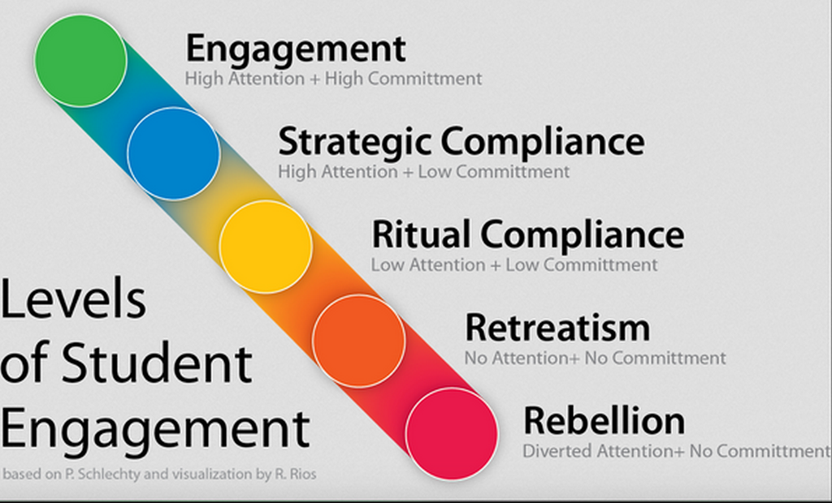
Levels of Student Engagement

Slide 5

Evidence based decision making
Measure student achievement and engagement
Analyse to optimise

Slide 6
What the research says…
  Survey data is a powerful tool for reflection to improve teaching and learning at the student,
  subject and school wide level
  Student Attitude and Engagement survey results
  are correlated highly to student achievement gains
  SAES (7-10) SAES (11-13)
Bill and Melinda Gates Foundation (2012). Asking students about teaching: Student perception surveys and their implementation. (MET Project Policy and Practice Brief). Retrieved from http://www.metproject.org/downloads/Asking_Students_Practitioner_Brief.pdf
Wiggins, G. (2011). Giving students a voice: The power of feedback to improve teaching. Education Horizons, 89(3), 23-26.

Slide 7
Attitude and Engagement Surveys?
Provide actionable feedback that schools and teachers can use to inform practice
Student and teachers are in a unique position to contribute to a comprehensive view of classroom practice because they experience it more than anyone else in the education system
The data can offer a big-picture view of what is happening in the classroom, subjects and school wide trends

Slide 8
CAM Student Attitude and Engagement Surveys
SAES (7-10), SAES (11-13)
Students’ perceptions of their school facilities, teachers and the classroom environment
Students’ attitudes to learning, work experience, assignments, coursework and study skills
Students’ future aspirations and career goals
Perceptions of subjects, effective teaching practices and barriers to learning

Slide 9

About your subjects
The lessons in this subject are well planned and organised
The notes and resources provided by the teacher are helpful for my study
Homework is set regularly and checked
The feedback provided for tests and exams is helpful
The atmosphere in the classroom supports my learning
The teacher was approachable
and supported my learning

Slide 10

How effective do you find each of the following to help your learning?
Presentation of a topic by the teacher
Dictation of notes
Working in pairs
Working in small groups
Working individually
Researching a topic
Presenting to the class
Helping another student
Class discussions
Worksheets
Using the Internet
Practical work
Experiments
Reading
Writing an essay
Practicing past exam papers

Slide 11

How satisfied are you with…….
Advice in choosing your subjects
Help on how to study
Changing a subject if it was unsuitable
Help with personal issues
Advice for future study
Career guidance
Explaining NCEA and how you are assessed
Work experience
Form teacher

Slide 12
NEXT STEPS
Using data for school improvement
Engage with national and school data
Analyse demographic, perceptual, student achievement, and survey data
Compare value added data for each subject
Identify effective best practice and share
Identify challenges and create strategies
Inform and facilitate professional development
Reflect on department practice and create goals
Support individual students and set achievement goals

Slide 13
To find out more
www.canterbury.ac.nz/cam/

