Slide 1
Developing a ‘Sense’ of Team (Part 1): Lessons from High Performing Teams
Andy Martin
&
Lana McCarthy

Slide 2
Overview
Team Culture & Leadership
International
All Blacks & Silver Ferns
National
Northern Mystics
Manawatu Turbos

Slide 3
Team Culture
Edgar Schein
Doyen on the subject
Seminal work
Simplicity
a pattern of shared basic assumptions learned by a group as it solved its problems of external adaptation and internal integration (Schein, 2010, p. 18)
3 level model
Artefacts
Values
Core assumptions

Slide 4
Leadership
Leadership style is central to influencing team culture, creating and reinforcing values.
Sports teams prefer a coach who exhibits transformational leadership, e.g. Sir Peter Blake (Nazari & Soharbi, 2014).
Transformational leadership influences team culture
facilitating shared vision, constant improvement, empowerment and leading by example.
The areas that we have needed to work on as coaches are developing our ability to grow self-awareness, understanding and problem-solving… we have had to become questioners. Instead of instructing all the time – technically and tactically (Wayne Smith, quoted in Johnson et al., 2014, p.196).

Slide 5
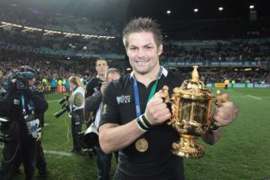
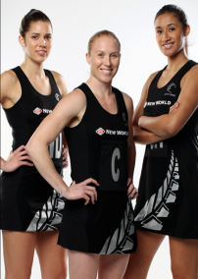
International: All Blacks & Silver Ferns
Core assumptions
Pride in selection
Pride in winning
Pride in the legacy
Learning culture
Learning & adapting to change
Collective leadership
Coach, captain & senior players
Values
Winning
Mateship
Symbols
The Jersey/Dress with the silver fern
Rites & Rituals
Haka
Back seat of the bus
Club All Black
All Blacks

Slide 6
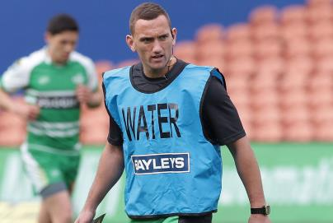
National: The Manawatu Turbos
“Every coach that I've been under in the Turbos has always put emphasis on culture.” Captain
‘Powering the grid’

Slide 7
National: The Northern Mystics
coach Debbie Fuller “puts the harmonious atmosphere throughout the whole team and management down to positive intent…
I think there’s a real curiosity in the team this year, they’ve really come together…
There’s real intent and willingness in the group to do the right thing, to work to capacity in every training session and that makes a huge difference - it makes my job easy.”

Slide 8
Conclusions
The team culture and leadership theoretical framework of Edgar Schein has been highlighted
Artefacts: stories, rites & rituals
Values
Core-assumptions
Team leadership has moved beyond the traditional view to a more shared-influence process, that is, beyond a leader-centric specialized role that focused on behaviours of leaders and performance of followers.
The development of a collective leadership approach and a learning culture establishes a more formalised identity and culture that is performance driven.

Slide 9
References
Johnson, T., Martin, A. J., & Watson, G. (2014). Legends in black: New Zealand rugby greats on why we win. Auckland: Auckland. Penguin.
Johnson, T., Martin, A. J., & Palmer, F. R., Watson, G., & Ramsey, P. (2013). A core value of pride in winning: The All Blacks’ team culture and legacy. International Journal of Sport in Society, 4(1), 1-14.
Johnson, T., Martin, A. J., & Palmer, F. R., Watson, G., & Ramsey, P. (2013). Artefacts and the All Blacks: Rites & rituals, symbols & stories. Sporting Traditions Journal, 30(1), 43-59.
Johnson, T., Martin, A. J., & Palmer, F. R., Watson, G., & Ramsey, P. (2012). Collective leadership: A case study of the All Blacks. Asia-Pacific Journal of Management and Business Application, 1(1), 53-67.

Slide 10
Developing a ‘Sense’ of Team (Part 1): Lessons from High Performing Teams
Andy Martin
&
Lana McCarthy

