Slide 1
EXPECT: Japan’s Perception and Expectations of EU The case of Social Media
SHAO Jingkai
Waseda University
September 22, 2022

Slide 2
Content
1 | Monitored platform and accounts
2 | Activeness of EU & Hot issues
3 | Sources
4 | Centrality
5 | Level of focus/ Domesticity
6 | Action & themes
7 | Bilateral relations
8 | Evaluation & netizens’ reactions
9 | Self-image and Asia’s expectations
10 | Visual images
11 | Conclusions

Slide 3
1. Popularity of social media platforms
 | Platforms | Market size
1st | LINE | 86 million users, 68% of the total population
2nd | Twitter | 58.95 million users, 52.3% of the total population
3rd | Instagram | 39.8 million users, 31.6% of the total population
Source:
https://www.bigbeatinc.com/blog/japan_social_media_2022
https://tam-tamlo.com/en/307

Slide 4
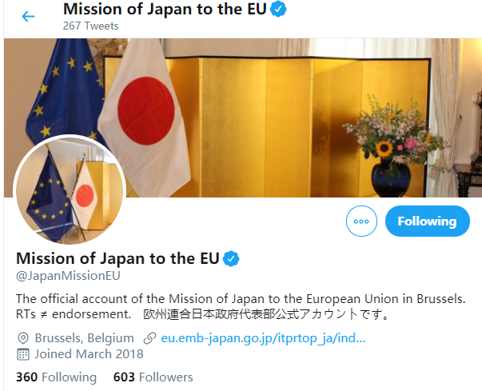
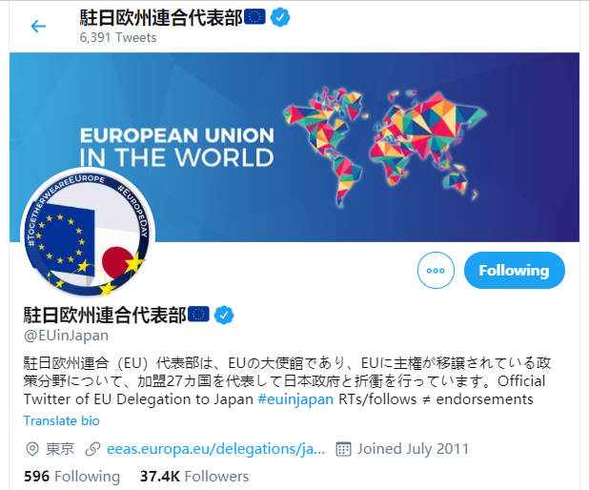
Monitored Social Media accounts in Japan
駐日欧州連合代表部 (@EUinJapan) Mission of Japan to the EU (@JapanMissionEU)
(EU delegation to Japan)

Slide 5
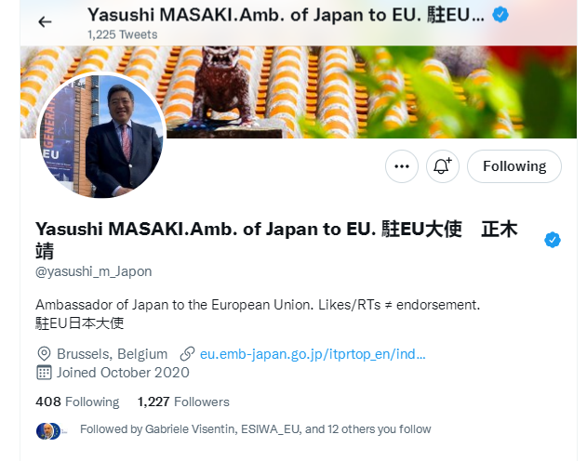
Yasushi MASAKI.Amb. of Japan to EU. 駐EU大使 正木 靖
(@yasushi_m_Japon)
No. of followers | 1, 227
No. of following | 408
Time of account creation | October 2020
Time of inauguration | October 2020
Reposted by EUD (March-June 2021) | 2 (2 direct)
Reposted by JPM (March-June 2021) | 33 (20 direct + 13 quote)

Slide 6
2. Activeness of accounts (n=942)

Slide 10
Other hot issues in EUD account

Slide 11
Other hot issues in JFM account

Slide 12
3. Sources (n=942)

Slide 13
Sources of reposts
 | EUD |  | JPM
 | 2020 | 2021 | 2020 | 2021
1st | European Commission | eufilmdays | MOFA of Japan | Yasushi MASAKI.Amb. of Japan to EU.
2nd | European External Action Service - EEAS | European Commission | / | European Policy Centre
3rd | eufilmdays | European External Action Service - EEAS |  | MOFA of Japan

Slide 14
4. Centrality of EU (n=942)

Slide 15
5. EUD’s Level of Focus (all posts)

Slide 16
Domesticity of JPM posts (all posts)

Slide 17
6. EU actions (Main/2nd focus, n=770)

Slide 18
Leading #hashtag (Major/2nd)

Slide 19
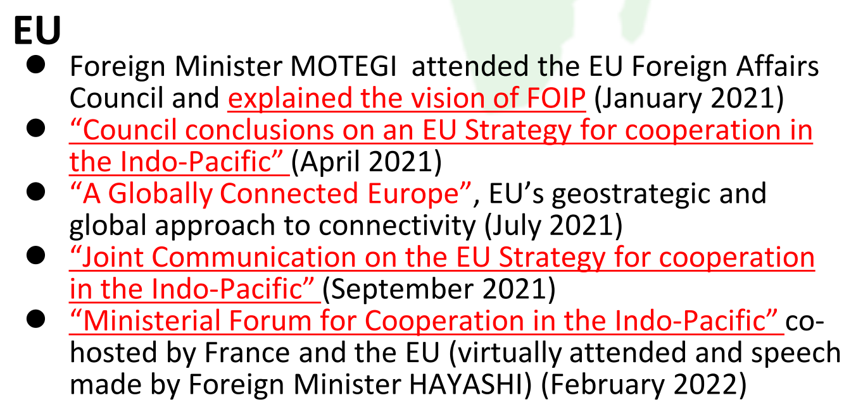
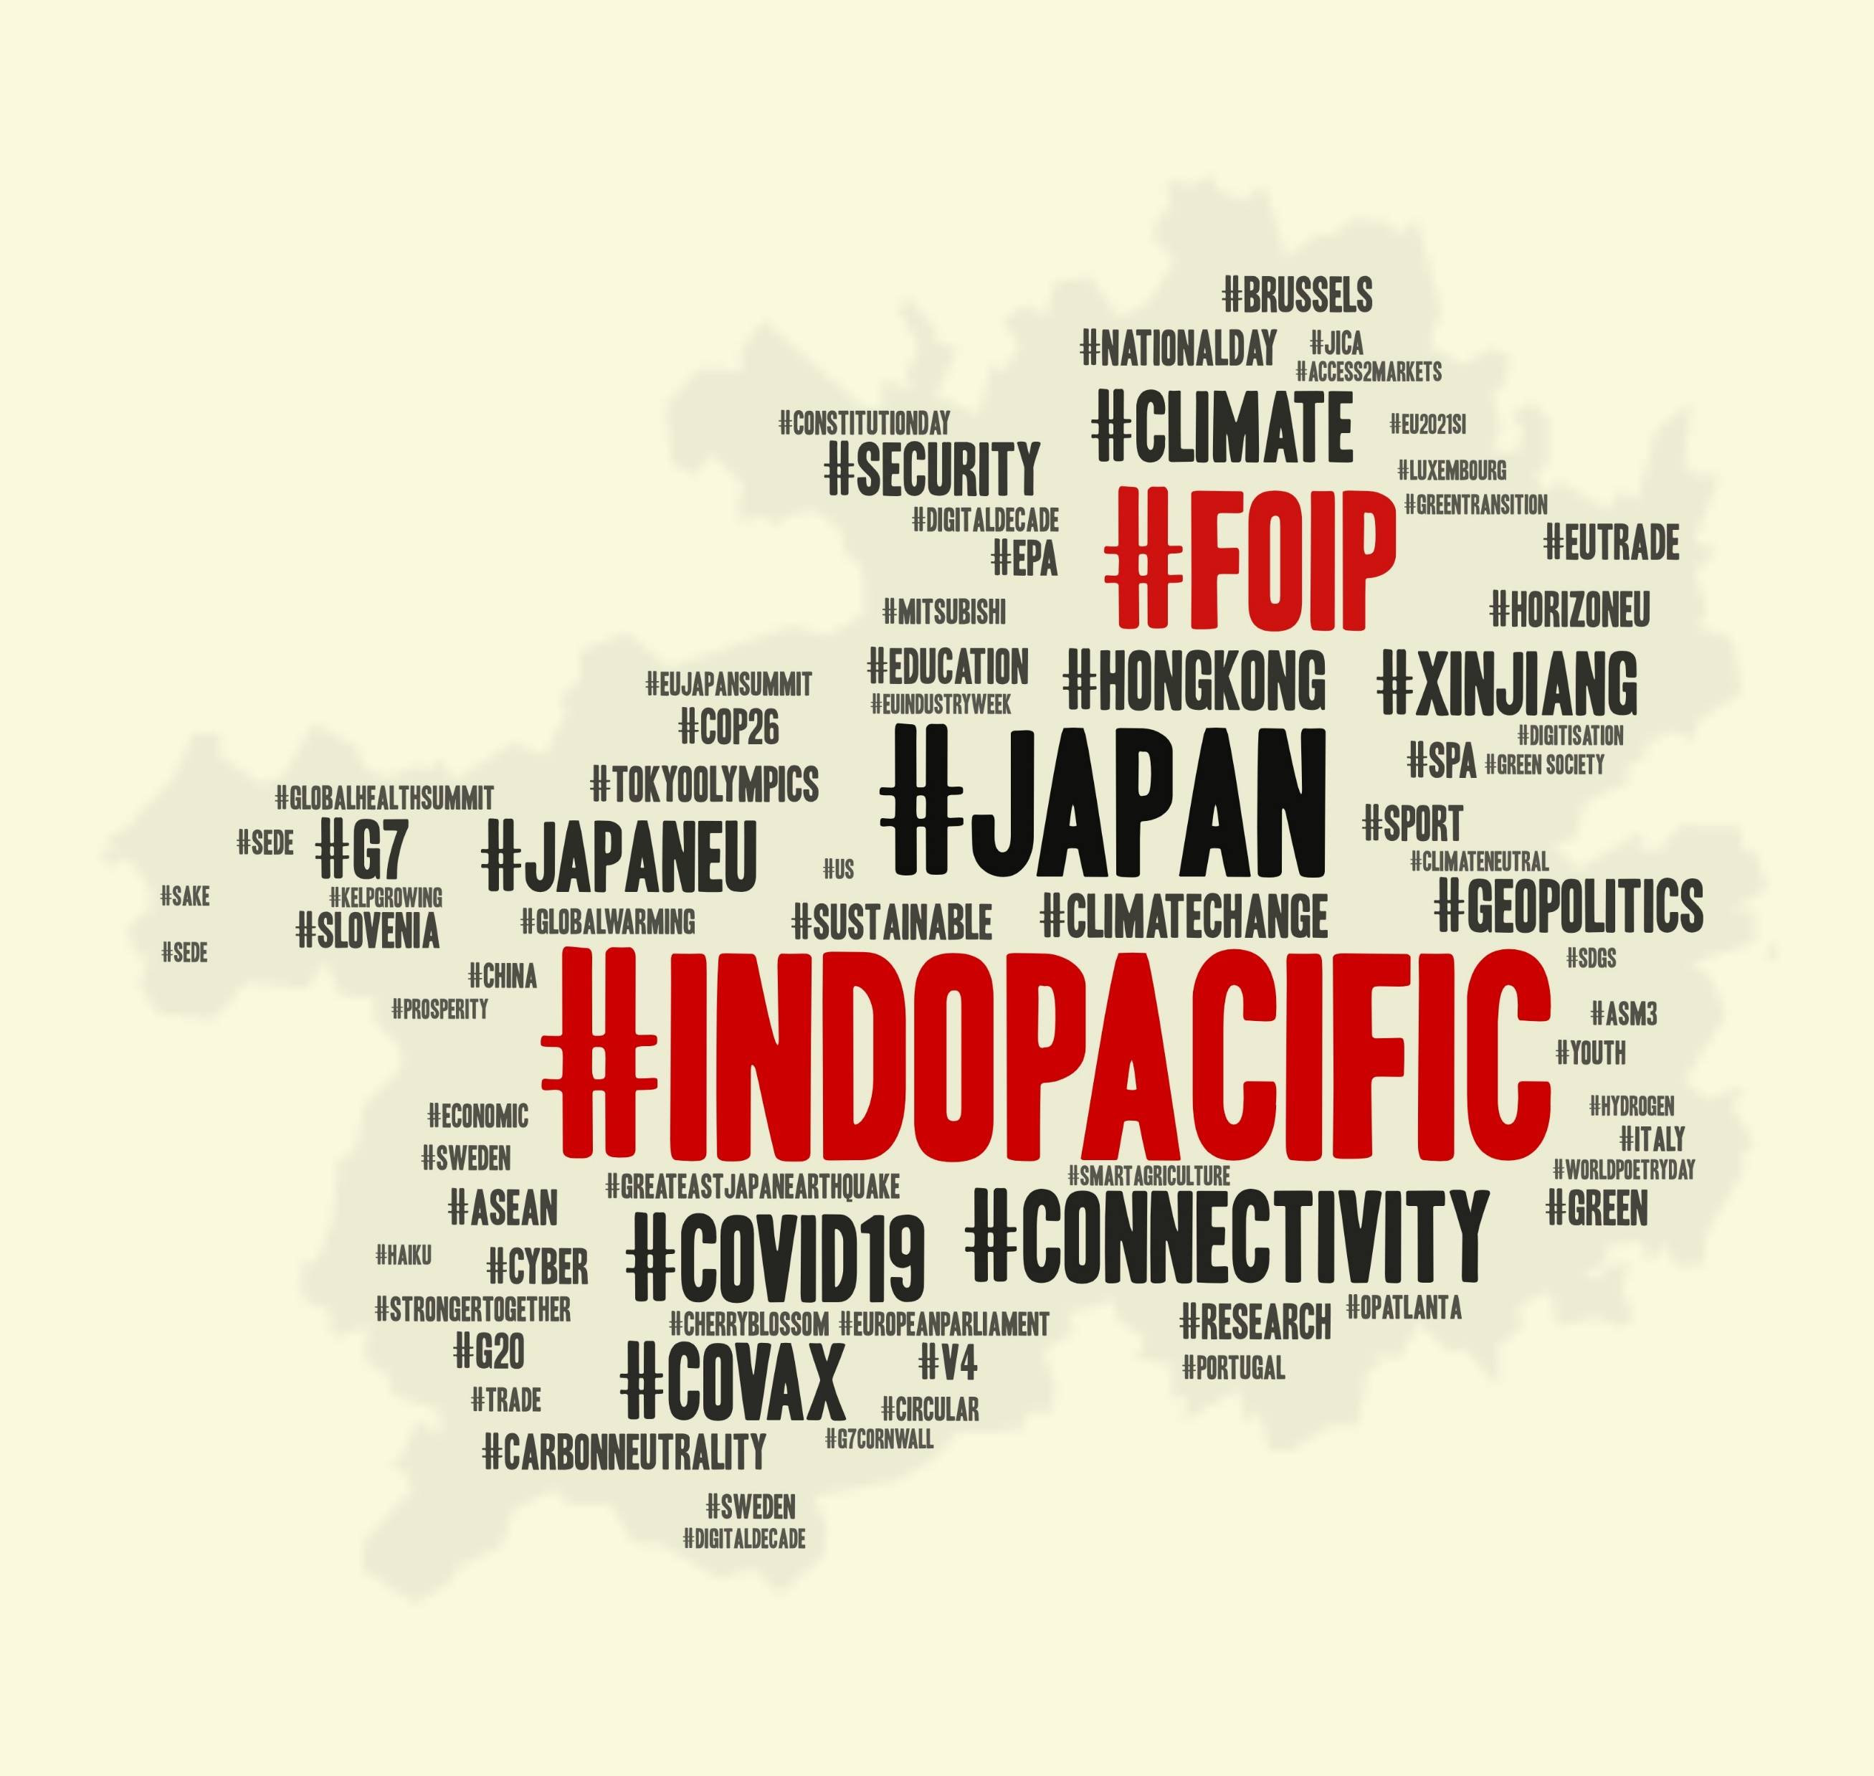
Expectation Keyword: Indo-Pacific
EU-Japan cooperation on FOIP ("Free and Open Indo-Pacific") Vision
Minister Motegi welcomed the Council conclusions on the “EU Strategy for cooperation in the Indo-Pacific” as EU’s strong will for its engagement with the Indo-Pacific region. High Representative Borrell expressed his gratitude for Minister Motegi’ s explanation of the vision of a “Free and Open Indo-Pacific (FOIP)” at the EU Foreign Affairs Council in January, and stated that it contributed to the formulation of the “EU Strategy for cooperation in the Indo-Pacific”.
(Japan-EU Foreign Ministers’ Meeting, May 4, 2021)
DM Kishi also emphasized the importance of Japan and EU nations’ confronting them together, that are sharing common values, and making our cooperation for maintaining and enhancing the vision of a “Free and Open Indo-Pacific” irreversible.
(Kishi Nobuo, the first Japanese defense minister to speak at the European Parliament, June 17, 2021)
Word cloud of hashtags of tweets from “Mission of Japan to the EU” (@JapanMissionEU)
Source: MOFA, Japan

Slide 20
Intra-EU actions (Major/2nd)

Slide 21
Sub-frame of intra-EU actions (Main/2nd focus)
2020
 | EUD | JPM
Promoting our European Way of Life | Health | /
An Economy that Works for People | Economy | /
EU integration | Europe Day | /
2021
 | EUD | JPM
Promoting our European Way of Life | Health | Culture (Sports)
An Economy that Works for People | Economy | /
EU integration | Europe Day | Europe Day

Slide 22
Extra-EU actions (Major/2nd)

Slide 23
Sub-frame of extra-EU actions (Main/2nd focus)
2020
 | EUD | JPM
A stronger Europe in the world | CFSP | CFSP
Promoting our European Way of Life | Health | /
An Economy that Works for People | Trade | /
2021
 | EUD | JPM
A stronger Europe in the world | CFSP | CFSP
Promoting our European Way of Life | Health | Research
An Economy that Works for People | Trade | Trade

Slide 24
7. Bilateral relation (Main/2nd focus)

Slide 25
Bilateral relation with Japan (Main/2nd focus)
 |  | 2020 | 2021
EUD | 1st | Bilateral Summit | EU Film Days
 | 2nd | EU Film Days | Vaccine export
 | 3rd | Cooperation in COVID-19 pandemic | Bilateral Summit
JPM | 1st | Bilateral Summit | Indo-Pacific Strategy
MFA | 2nd | Bilateral cooperation in science & technology | Ambassador activities
 | 3rd | Bilateral economic and trade relations | Green Alliance

Slide 26
8. Evaluation of EU (Major/2nd, n=770)

Slide 27
Evaluation of intra-EU actions

Slide 28
Evaluation of intra-EU action (Main/2nd focus)
 |  | Leading +ve Story
EUD | 2020 | EU's response to COVID-19
 | 2021 | EU's response to COVID-19
JPM | 2020 | /
 | 2021 | EU-Japan joint research projects

Slide 29
Most popular posts of intra-EU story
 |  | Most liked | Most commented | Most shared
EUD | 2020 | European integration history | International Women's Day | Forecast of Europe Day
 | 2021 | International Women's Day | International Women's Day | International Women's Day
JPM | 2020 | / | / | /
 | 2021 | Music Europe Day | Music Europe Day | Music Europe Day

Slide 30
Evaluation of extra-EU actions

Slide 31
Evaluation of extra-EU action (Main/2nd focus)
 |  | Leading +ve Story
EUD | 2020 | EU's response to COVID-19
 | 2021 | EU's COVID-19 aid
JPM | 2020 | Bilateral Summit
 | 2021 | Indo-Pacific Strategy

Slide 32
Most popular posts of extra-EU story
 |  | Most liked | Most commented | Most shared
EUD | 2020 | A Japanese pianist playing "Ode to Joy" at home. | EU's 2030 Biodiversity Strategy | A Japanese pianist playing "Ode to Joy" at home.
 | 2021 | EU’s vaccine exports to the world and Japan | EU’s vaccine exports to the world and Japan | EU’s vaccine exports to the world and Japan
JPM | 2020 | HorizonEU & Moonshot R&D programmes | HorizonEU & Moonshot R&D programmes | HorizonEU & Moonshot R&D programmes
 | 2021 | DM Kishi's attendance at the EP | 10th anniversary of 3/11 disaster | DM Kishi's attendance at the EP

Slide 33
9. Self-image built by EUD (Main/2nd)
 | 2020 | 2021
1 | Protector of public health | Aid provider
2 | Aid provider | Partner of Japan
3 | Partner of Japan | Protector of environment

Slide 34
Expectation in JPM account (Main/2nd)

Slide 35
Japan’s Expectation on EU
 | 2020 (0 expectation) | 2021 (11 expectations)
1st | - | Bilateral security cooperation in the Indo-Pacific region
2nd | - | Further collaboration in Education, Science, Technology and Innovation
3rd |  | Jointly defend the rules-based global order

Slide 36
Reported EU’s self-expectation
 | 2020 (4 expectations) | 2021 (23 expectations)
1st | Solidarity in the COVID-19 pandemic | Be a global leading security provider
2nd | An independent global player under the China-US competition | Lead the combat against climate change
3rd | Enhancing innovation capacity | Resist & engage Russia

Slide 37
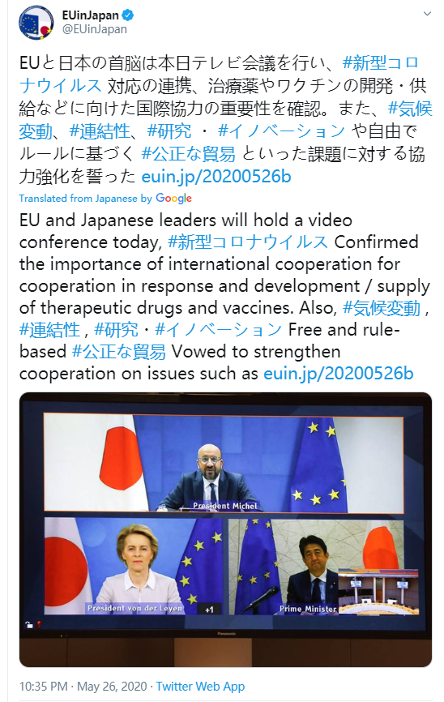
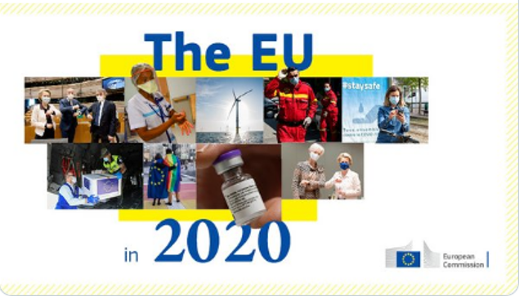
10. Pictures in EUD (2020 versus 2021)

Slide 38
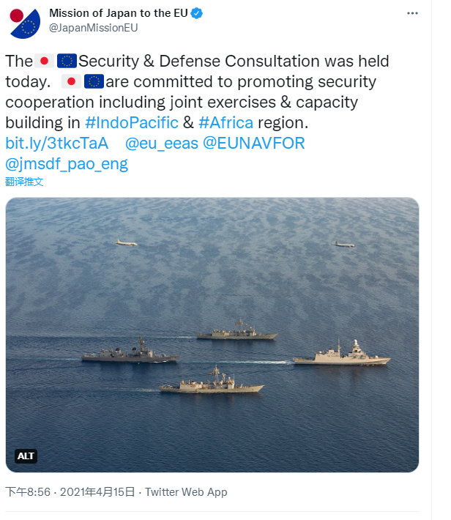
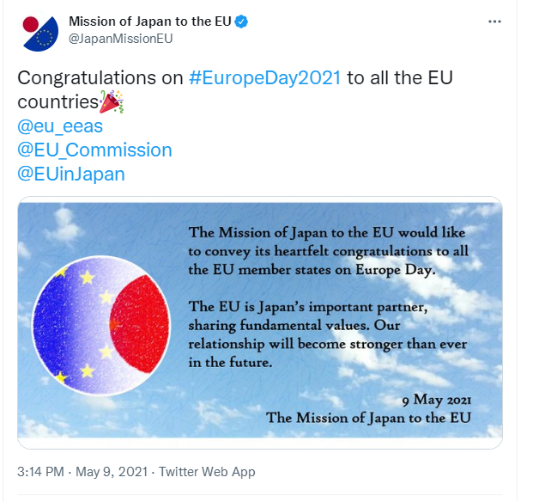
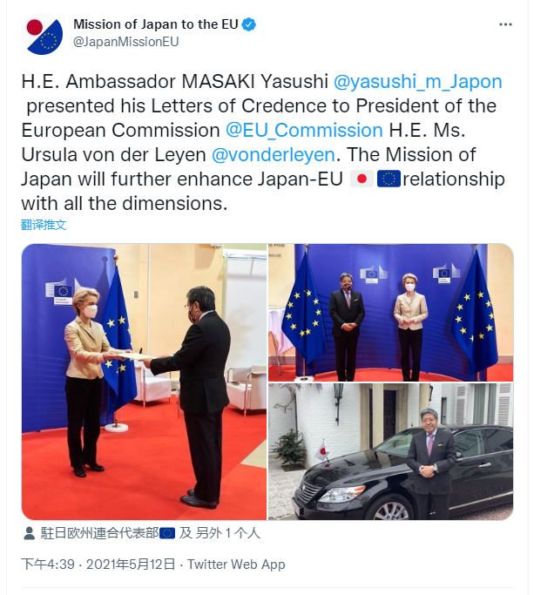
Pictures in JPM (2020 versus 2021)

Slide 39
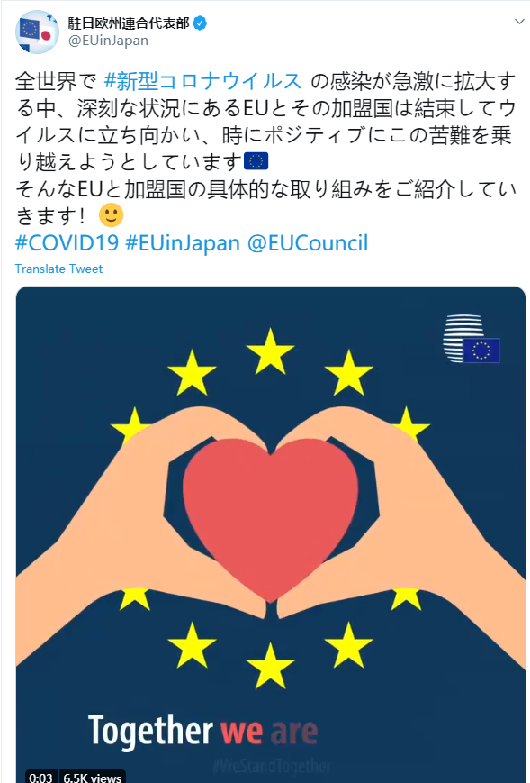
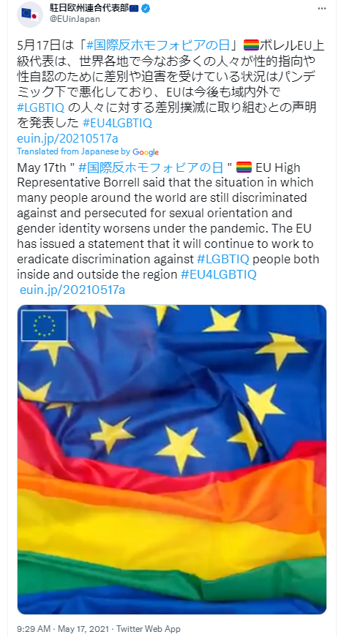
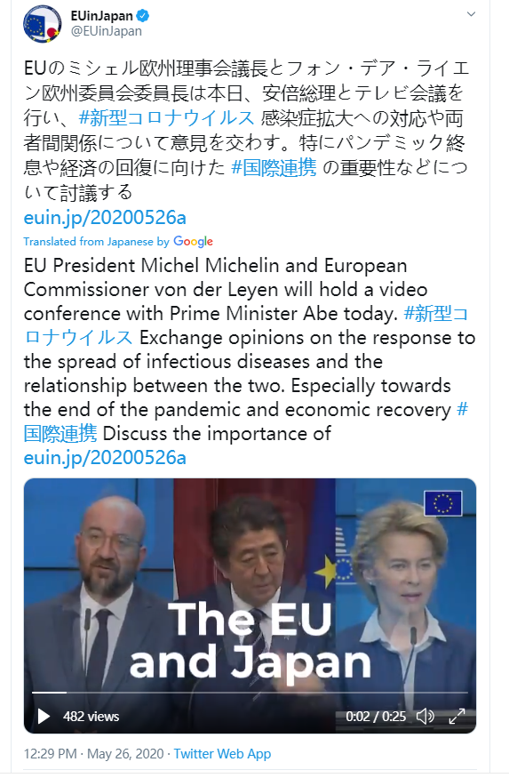
Videos in EUD (2020 versus 2021)

Slide 40
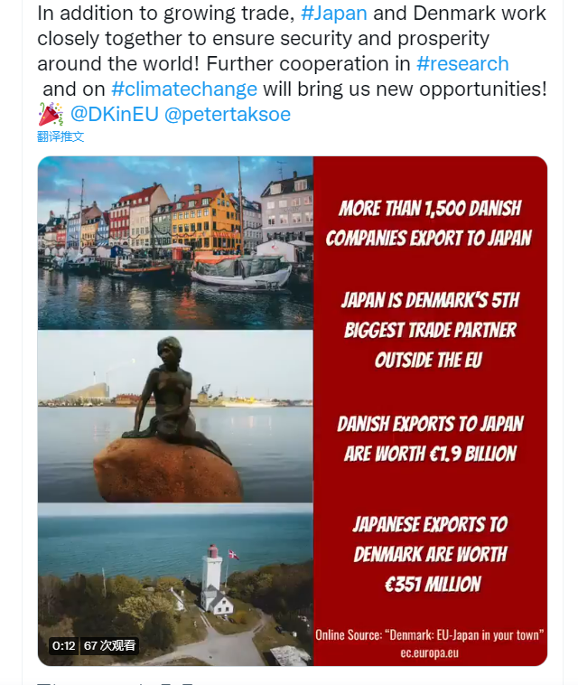
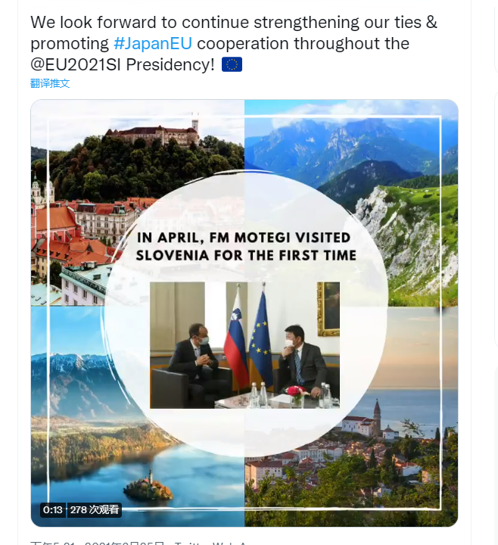
Videos in JPM (2020 versus 2021)

Slide 41
Conclusions
EU Delegation in Japan:
Public diplomacy tool (EEAS),
Self-image building and norm diffusion,
Online and offline connections,
Window of CFSP,
PR campaigns (a theme a month),
Network of EU MS in Japan/EU Institution accounts
Mission of Japan to the EU :
Bulletin of bilateral official news
(news from MOFA + retweets from other accounts) （2020）
Public diplomacy platform （2021）

Slide 42
Conclusions (2)
Much more active online PR campaigns from Japan to the EU
No. of post: 2020 (9) → 2021 (168, EU-related only)
The new ambassador (since October 2020): MASAKI Yasushi
(official account 19.6% retweeted)
2. Different focuses
EU: values/norm diffusion, CFSP, EU-centered (only 18.7% bilateral relations)
Japan: Bilateral relations (72.7%), Japan’s foreign policy (but Japan is also eager to use social media to as a public diplomacy platform, e.g., introducing Japanese culture, domestic achievements)
3. Common interests and cooperation between like-minded partners
Indo-Pacific (rules-based order, liberal democracy, maritime security, connectivity, quality infrastructure)
“Green Alliance” (Advanced Biofuels & Alternative Renewable Fuels, Green transition)
SPA/EPA (COVAX, 2030 Agenda for SDGs, human rights, good governance, multilateralism and open market economies)

Slide 43
THE END THANK YOU!

