Slide 1
GAME SENSE; Some thoughts and applications in the Elite Rugby Coaching context.
John McKee; University of Canterbury. November 2015

Slide 2
The “Shape” of the Game
 | 1995 | 2011 | % change
Ball in Play | 33% | 44% | Up 33%
Rucks / Mauls | 69 | 162 | Up 135%
Passes | 179 | 263 | Up 47%
Kicks | 75 | 41 | Down 45%
Scrums | 27 | 17 | Down 37%
Lineouts | 37 | 24 | Down 35%

Slide 3
My Coaching Philosophy Development
WILLINGNESS TO LOOK OUTSIDE RUGBY FOR INNOVATIVE COACHING METHODOLOGIES
Attending Rod Thorpe Seminars in Sydney, Australia, Mid-Late 90’s.
Wayne Smith / Dave Hatfield Presentation at 1999 Australian National Coaching Conference, in Melbourne.
France Experience 2000-2002 in discussion with Pierre Villepreux FFR National Coaching Director
Putting into practice as Head Coach
  Eastwood Rugby Club 1999 & 2000
  Central Coast Rays 2007
  Warringah Rugby Club (NSW Premier Rugby) 2008
  John Evans 2008; Coaching Methodology Discussion & Coaching Review.

Slide 4
Coaching the Flying Fijians
Game Style to suit unique Fiji player profile.
Working in short time frames from team assembly to Competition.
Training specifically to play Flying Fijian Game.
Create a learning environment through training.
Improve decision making & skills under pressure through modified training games.
  Limiting Time & space and manipulating ‘opportunity’.
Using Game Senario training to develop specific elements of Game Plan.
Developing Game Specific fitness through games & game like senario training.

Slide 5
Flying Fijians successful ‘Game Plan’; Attacking Requirements
Getting ball to 15m channel to exploit;
  Possible numbers advantage
  Possible miss-matches
  Create1 v 1’s, 2 v 2s with space.
Backs carrying the ball more times than the Forwards throughout the game
Effective Exit Game from defensive field position to attacking field position to;
  Play field position game. (our set play or possession in their 50m)
  Create counter attack opportunities (from kick return)

Slide 6
Training Games to Develop Game Plan
Attack scenarios with continuity (& turnovers)
  Create incentive to get ball to 15m channel
    restrict defence,
    score points for getting ball wide,
    extra time in possession for attacking
  Understand that in games you don’t get ‘2nd chance’ following error or poor execution.
Exit Game
  Kick Receipt with 2 touches allowed in own half & 4 touches in opposition half to turnover
    Decision making;
      Kick ball back directly
      Carry ball to get good setup for kick back
      Carry ball directly into opposition half

Slide 7
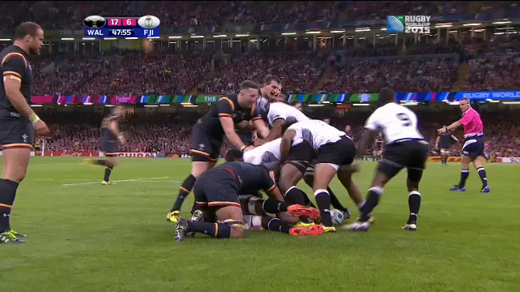
Attack to wide channels

Slide 8
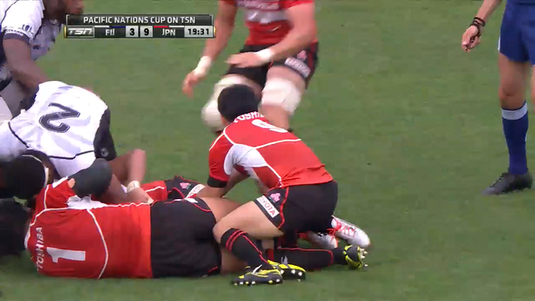
Counter Attack + Shape

Slide 9
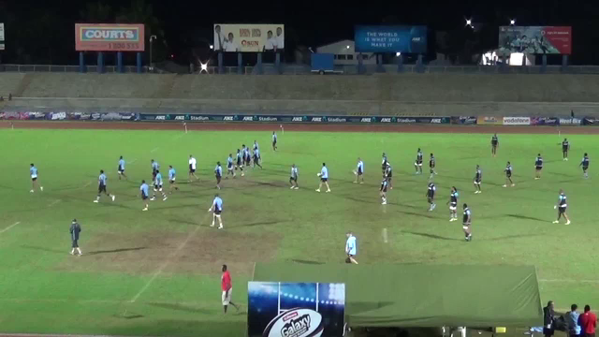

Slide 10
Game Sense Learning
Player Centered Coaching
Asking players open ended questions
  Was that a good option?
  Did you see any other options?
  Why didn’t that work?
  What do we need to do to make it work?
Builds confidence of the players within the game context
  Good decision making / Playing to Game Plan under pressure
  Play Makers build confidence in making good decisions
  Players build confidence & support Playmakers

Slide 11
In Conclusion
Games based training helps
  Players learn to make good decisions on & off the ball based on the Team Game Plans.
  Players improved learning in motivating training environments.
  Player confidence in ability to make good decisions in match situations.
  Transfer from learning environment at training to execution in Games.
  Players learning to ‘react’ with better decisions to situations as they open up in the game.

